Slide 1
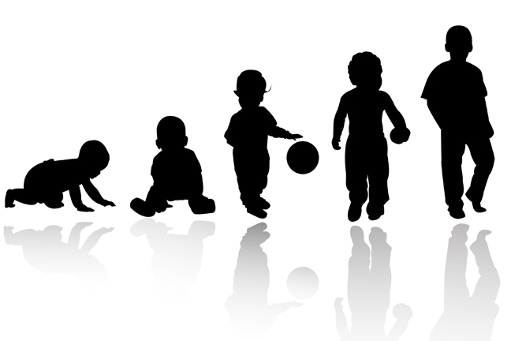
Lifespan Psychology: Infancy
AEPSY Year 11 ATAR Psychology

Slide 2
Review
Name the two components of the nervous system and state the function of each.
Which structures form the CNS?
Name two components of the PNS and then divide each into two further components.
Give two examples of sympathetic and two examples of parasympathetic responses.
Draw a motor neuron (labelled of course ;)

Slide 3
Learning Intentions
Lifespan psychology
developmental stages across the lifespan – prenatal, infancy
changes across developmental stages
physical (gross and fine motor skills)
cognitive (language)
social and emotional development

Slide 4
Success criteria
State that development is organised and sequential.
Explain the difference between physical, cognitive and social-emotional development.
Explain the difference between gross and fine motor skills (give examples).
List four newborn reflexes.

Slide 5
Developmental stages
From (and before) birth until death, humans continue to develop. Changes can be classified as
Physical (including gross and fine motor skills)
Cognitive (including language)
Social and emotional

Slide 6
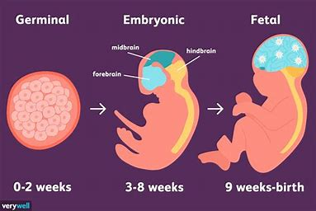

Slide 7
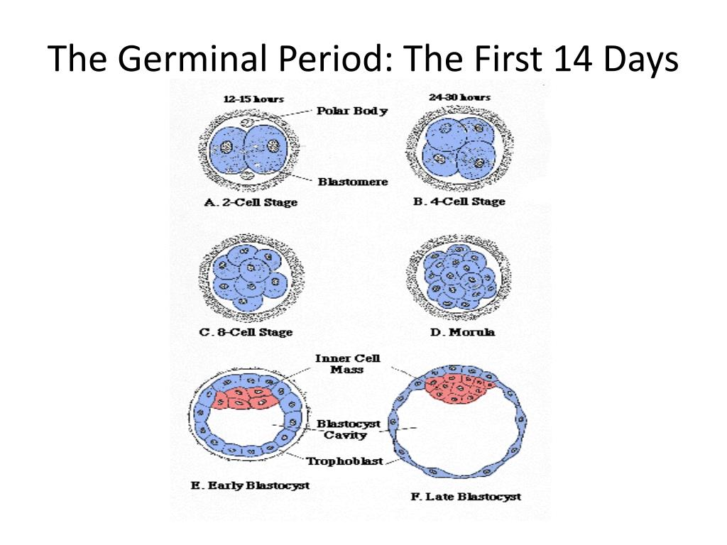
Prenatal development
From fertilisation, there is an ordered sequence of growth and changes.
Week 1-2 Germinal stage
From a single cell to hundreds of cells, the more a cell divides, the more it becomes specialised to form different tissues and organs.

Slide 8
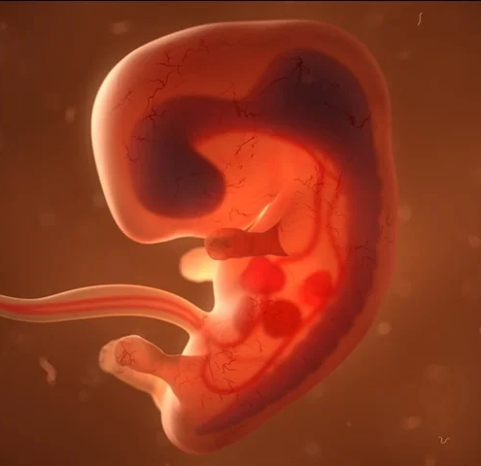
Prenatal development
Week 3-8 Embryonic Stage
Basic structures of the embryo start to develop, organs form and begin to function. The neural tube forms along the back of the embryo, developing into the spinal cord and brain.

Slide 9
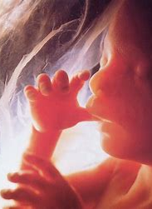
Prenatal development
Week 9-40 Foetal Stage
The brain and other organs continues to grow and develop. By 24 weeks the foetus can hear and respond to sounds.

Slide 10
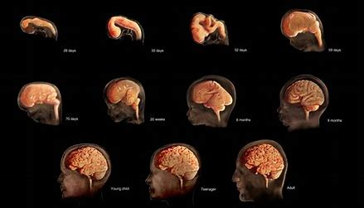

Slide 11
Question
1. At what stage of prenatal development does the CNS start to form?
2. When is the CNS growing fastest?

Slide 12
Infancy
A human is born with all the brain cells it will ever have, and throughout childhood neural connections will develop.
Healthy babies are born with newborn reflexes, which help it to survive until it is capable of more complex behaviours. Reflexes disappear in the first few months (up to a year).

Slide 13


Slide 14
Questions
3. List four newborn reflexes.
4. Choose one newborn reflex and describe how it helps the newborn to survive.
5. Why are these reflexes necessary?

Slide 15
Infancy
Although their senses are not fully developed, newborns are primed to recognise faces, human voices and their mother’s scent.

Slide 16
Motor development
Motor development occurs in an orderly sequence from reflex to more advanced, eg babies first learn to hold their heads up, then to sit with assistance, and then to sit unassisted, followed later by crawling and then walking.

Slide 17
Fine and gross motor skills
Fine motor skills focus on the muscles in our fingers, toes, and eyes, and enable coordination of small actions (e.g., grasping a toy, writing with a pencil, and using a spoon). Gross motor skills focus on large muscle groups that control our arms and legs and involve larger movements (e.g., balancing, running, and jumping).

Slide 18
Questions
6. Give one example of a fine motor skill and one example of a gross motor skill that an infant would be able to perform.

Slide 19
Cognitive development
Infants gain new abilities to think, problem solve, and communicate, eg infants shake their head “no” around 6–9 months, and they respond to verbal requests to do things like “wave bye-bye” or “blow a kiss” around 9–12 months. We can expect children to grasp the concept that objects continue to exist even when they are not in sight by around 8 months old.

Slide 20
Language development
Human babies are primed to learn language. At birth, babies recognise their mother’s voice and can discriminate between languages. Babies coo with accents!

Slide 21


Slide 22
Language development
Cooing is a one-syllable combination of a consonant and a vowel sound (e.g., coo or ba). After cooing, the baby starts to babble. Babbling begins with repeating a syllable, such as ma-ma, da-da, or ba-ba. When a baby is about 12 months old, we expect them to say their first word for meaning.

Slide 23
Questions
7. Which do you think would develop first? The ability to understand words, or the ability to say words?
8. How many parts of the brain are involved in hearing, vs understanding words, vs speaking?

Slide 24
Social emotional development
Babies form relationships, interact with others, and understand and manage their feelings. In social and emotional development, forming healthy attachments is very important and is the major social milestone of infancy.

Slide 25
Success criteria
State that development is organised and sequential.
Explain the difference between physical, cognitive and social-emotional development.
Explain the difference between gross and fine motor skills (give examples).
List four newborn reflexes.

